Slide 1

Paper Review “Measuring the Variability of Chain Ladder Reserve Estimates” by Thomas Mac
Chris Cirelli
09/27/2020

Slide 2
Objective
Purpose
To summarize the main points of the reference by Mack, T. titled Measuring the Variability of Chain Ladder Reserve Estimates (1993).
Paper Objectives
Challenge a commonly held perception that the Chain Ladder Reserve Estimate technique can be applied to any loss reserve scenario as it is devoid of any assumptions.
Mathematically prove
each of these assumptions and describe their implications for utility of this methodology for loss reserve estimations.
how the Chain Ladder Reserve estimate can be used to develop confidence intervals for estimating IBNR reserves.
How certain plains may be utilized to visualize these assumptions and applicability of the chain ladder method.
Notes:
His main objective is to challenge what he sees as a commonly help perception that the Chain Ladder Reserve method can be applied to any loss reserve triangle as it has few if any required underlying assumptions.
He seeks to achieve this by mathematically proving the existence of each of these assumptions and describing their implications for when this technique should be used.
Thereafter, and building on these assumptions, the author shows how once can calculate the standard deviation of the Chain-Ladder technique, why it is important.
He concludes with showing how certain plots can be used to visualize the assumptions and when the assumptions are not met,

Slide 3
Content
Brief Introduction to the Chain Ladder Reserve Technique
Key Assumptions
Standard deviation and Confidence Intervals
Validation
Notes:
The purpose of this presentation is to provide a brief overview of the key topics addressed by Thomas Mack in “Measuring the Variability of Chain Ladder Reserve Estimates”.
We will start with an overview of the objective of the paper and what the author hopes to achieve.
Thereafter, we will discuss the primary assumptions and or key points that the author is trying to make
Thereafter, we will review the calculation for the stdev
And validation of when to use the model.

Slide 4
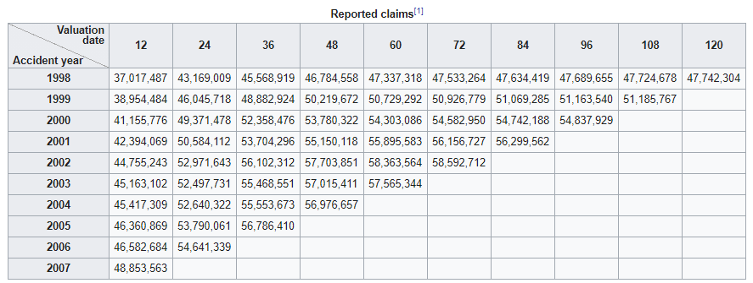
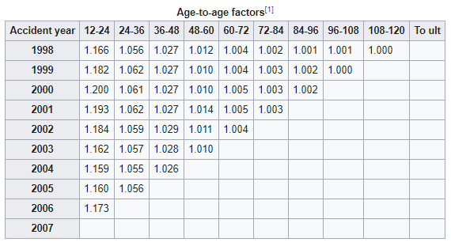
Introduction – Chain Ladder Reserve Technique
Description
Chain Laddering is a technique for estimating ultimate IBNR claim amounts.
A key assumption of the chain ladder method is that historical patters in claims activity will persist in the future.
Utilizing age-to-age factors calculated from loss triangles in order to estimate subsequent loss periods.
Example

Slide 5
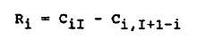
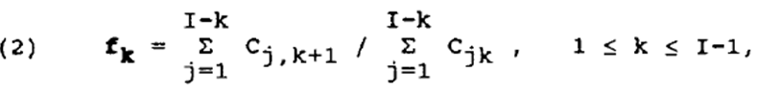
Assumption 1 & 2
All future periods are random variables & All accident years are independent
Outstanding Claim Reserve – Accident year (i)
The amount to be estimated from accident year i…..I
Age-to-Age factor used to estimate the subsequent years reserve amount
Expectation
Notes:
Notes:
Ri Represents the outstanding claims reserve of accident year i as Ci, I+1 – i has already been paid out / is known.
CiI Is the amount of the estimate, from accident year “i” to “I”
Ci The amount of reserves known.
CiI is the projection of the ultimate claim amount and is the product of Ci * an age-to-age factor Fk
Fk
Assumption:
Because we are only using the immediate preceding year to calculate the next year, we can consider all Cik to be random variables.
Page 107 “The chain ladder method assumes the existence of accident-year-independent factors F1……FI-1, such that
Formula The expectation of (Ci, k+1) the next period
Is equal to Cikfk where I is greater than 1 and less than I
Explanation 3 is a conditional expected value
This assumption is implicitly underlying the chain ladder method.
Support
(1) Formula (1) uses the same age-to-age factor for every accident year.
Formula (1) only uses the most recent observed values Ci, as the basis for projecting to the ultimate, ignoring earlier amounts.
Subsequent development factors are uncorrelated
Because Cik is a scalar and the formula only relies on the current k to make the next projection, all subsequent fk’s are uncorrelated.
The development factor will be the same after a high cik value as a lof cik value.
It almost seems like what he is saying is that we should not use the chain rule where we expect to have very volatile year to year changes in reserves.
Assumption 1:
All future periods are random variables.
Assumption 2:
Because the chain ladder method in neither 1 & 2 takes into consideration any dependency between the accident years, we can conclude that the independence of the accident years is also an implicit assumption.

Slide 6
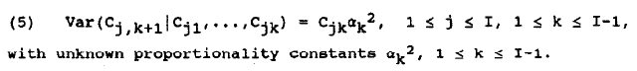
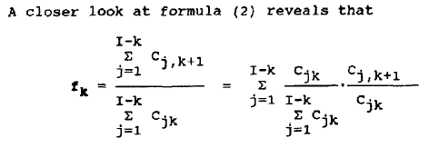
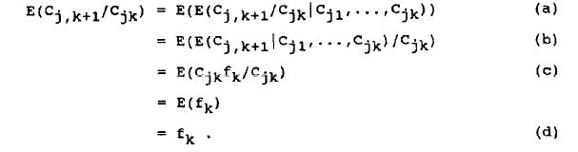
Assumption 3
The variance of Cj is equivalent to Cjk times some proportionality constant alpha k^2.
Formula 2 is the weighted average of the observed individual development factors
Indv. Development factor is an unbiased estimator for fk
Notes:
Independence of Accident Years
Because the chain-ladder method takes into account any dependency between the accident years we can conclude that the
independence of the accident years.
Cannot be assumed for every run-off triangle as certain changes, like inflation or major changes in claims handling can affect several accident years.

Slide 7
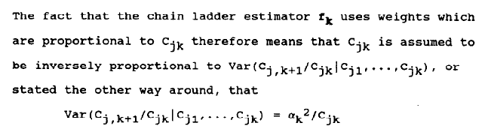
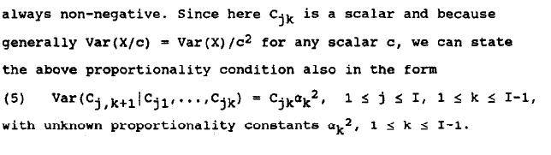
Cjk is assume to be inversely proportion to Var(Cj / Cjk) or alpha*k^2 / Cjk
The variance of Cj, k+1 is equal to Cjk time some constant alpha k ^2

Slide 8
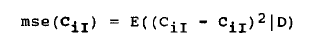

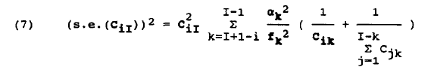
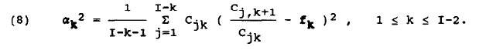
Calculating Variance
Point estimate for the future time period will always include a margin of error.
We want to know if the estimator CiI is at least on average equal to the mean of CiI.
Also want to know the average distance for each point estimation.
MSE
Var(X)
Sqrt of MSE is Standard Error
MSE depends on an unknown parameter fk and alpha k^2.
Must develop an estimator for mse(CiI) & sqrt is SE.
Which is also the standard error of the reserve estimate Ri.
Notes:
We want to know if our estimator for the ultimate IBNR is on average equal to the mean of the actual.

Slide 9
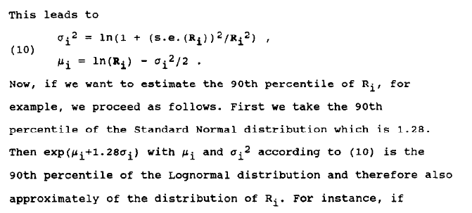
Calculating Confidence Intervals (CI)
Claims can never be 100% accurately predicted
CI help facilitate business decision integration into reserving policy as they provide a confidence probability.
Comparison with other claim reserving practices (comparing CI’s).
CI only for Ri.
If the volume of claims is large, rely on central limits theorem and assume distribution of Ri is normal.
Will not hold for all scenarios. Therefore, take log normal
Notes:
CiI is a point estimate formula
Will always contain error as we are dealing with random variables.
MSE Distance metric used to measure difference between point estimate and actual.

Slide 10
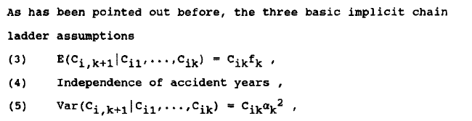
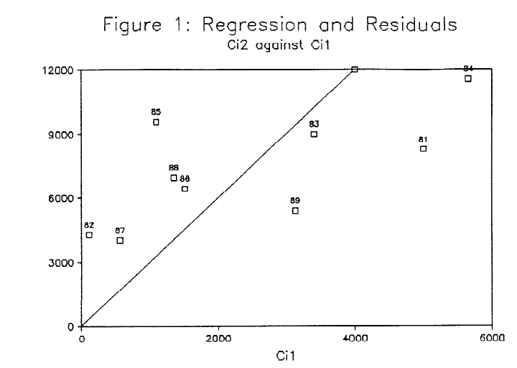
Verifying Assumptions
Review of Assumptions
These implicit assumptions may not be met for every scenario.
Utilize OLS method to estimate fk.
Facilitates utilizing OLS instruments to check underlying assumptions.
For instance, plotting the residuals to check for constant variance and if there are not trends.

Slide 11
Final Remarks
Chain Ladder Weak Points
The estimators of the last two or three factors rely on very few observations.
That the known claim amount for the last accident year forms a very weak basis for a forecast to ultimate.
Despite that statistical methods developed to test the applicability of the chain ladder method, one should obtain insight from actuaries and or underwriters knowledgeable about the business.

